Slide 1
Chapter 16

Slide 2
Objectives

Slide 3
Objectives (continued)

Slide 4
The syntax for creating an array

Slide 5
The syntax for creating an array and assigning values in one statement

Slide 6
How to create an array and assign values in one statement

Slide 7
The syntax for referring to an element of an array

Slide 8
How to assign values to an array by accessing each element

Slide 9
A property for an array

Slide 10
How to add an element to the end of an array

Slide 11
How to add an element at a specific index

Slide 12
How to remove all elements

Slide 13
A sparse array that contains 999 undefined elements

Slide 14
Code that puts the numbers 1 through 10 into an array

Slide 15
Code that computes the sum and average of an array of totals

Slide 16
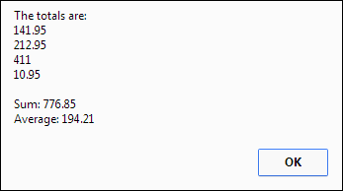
The message that’s displayed

Slide 17
The syntax of a for-in loop

Slide 18
A for-in loop that displays the numbers array in a message box

Slide 19
Code that shows the difference between for and for-in loops

Slide 20
The difference between for and for-in loops (continued)

Slide 21
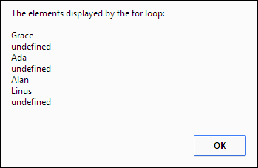
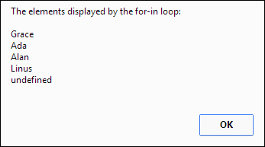
The messages that are created by the loops

Slide 22
The methods of an Array object that accept simple parameters

Slide 23
The methods of an Array object that accept simple parameters (continued)

Slide 24
Methods of an Array object that accept functions as parameters

Slide 25
The syntax of the function for the sort() method

Slide 26
How to use the push() and pop() methods to add and remove elements

Slide 27
How to use the slice() and concat() methods

Slide 28
How to use the join() and toString() methods

Slide 29
How to use the sort() method

Slide 30
How to use the map() method

Slide 31
How to use the filter() method

Slide 32
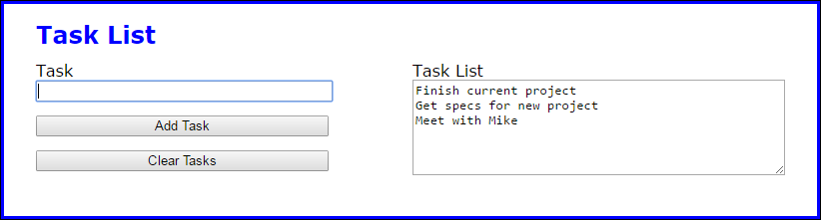
The Task List application

Slide 33
The JavaScript for the Task List application

Slide 34
The JavaScript (continued)

Slide 35
A String method that creates an array

Slide 36
How to split a string that’s separated by hyphens into an array

Slide 37
How to split a string into an array of characters

Slide 38
What happens if the string doesn’t contain the separator

Slide 39
How to get just one element from a string

Slide 40
How to create an associative array with four elements

Slide 41
How to add an element to the associative array

Slide 42
How to retrieve and display the elements in the associative array

Slide 43
How to use a for-in loop with the associative array

Slide 44
How to create and use an array of arrays

Slide 45
How to create and use an array of associative arrays

Slide 46
How to create and use an array of associative arrays (continued)

Slide 47
The Task List 2.0 application

Slide 48
The HTML for the Task List 2.0 application

Slide 49
The JavaScript in the document.ready() function

Slide 50
The JavaScript (continued)

Slide 51
The JavaScript (continued)

Slide 52
Exercise 16-1 Enhance the Task List app

Slide 53
Exercise 16-2 Enhance the Task List 2.0 app

Slide 54
Extra 16-1 Develop the Student Scores app

Slide 55
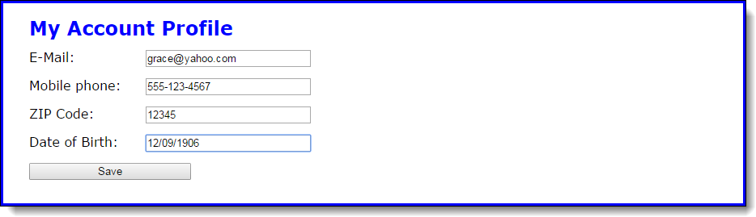
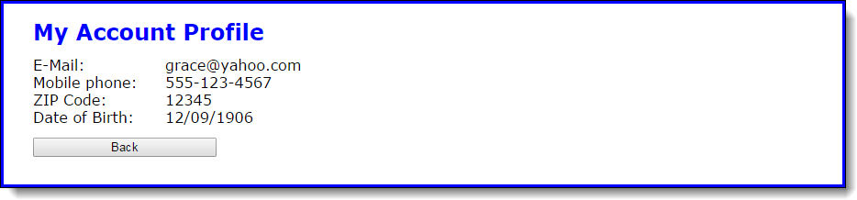
Extra 16-2 Change the Account Profile app to use an associative array

Slide 56
Short 16-1 Allow multiple tasks in a single entry

